Slide 1
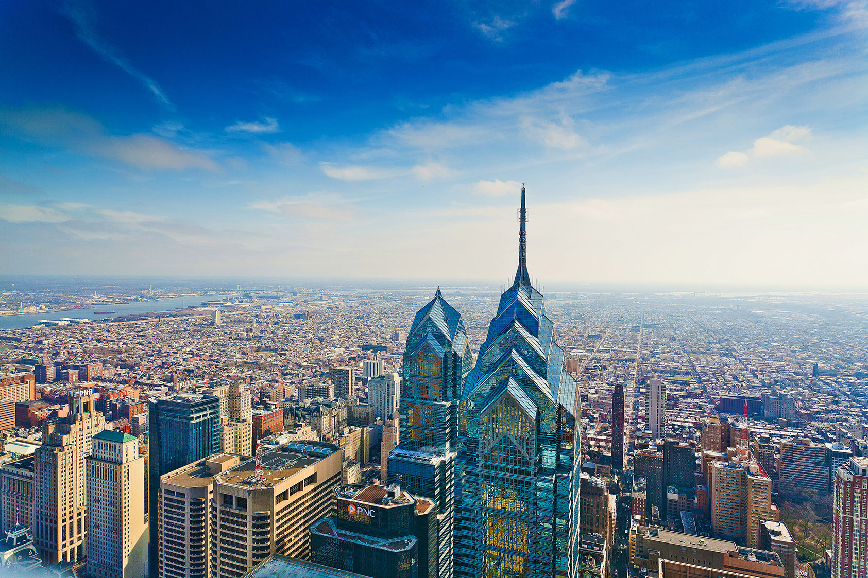
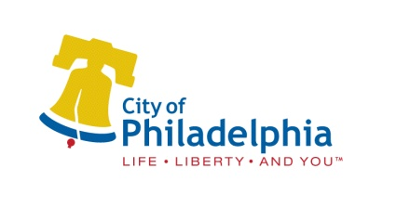


June 21, 2016
Philadelphia
Smart City. Smart Choice.

Slide 2
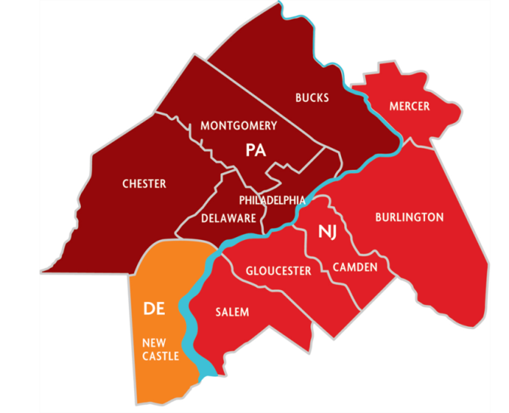
Greater Philadelphia: Quick Facts
Population
  6.4 million (7th)
Employment
  3.0 million (6th)
Personal Income
  $328 billion (6th)
Gross Regional Product
  $405 billion (7th)
Sources: IHS Global Insight, 2013, U.S. Bureau of Labor Statistics, 2013, U.S. Census Bureau, 2012 Census

Slide 3
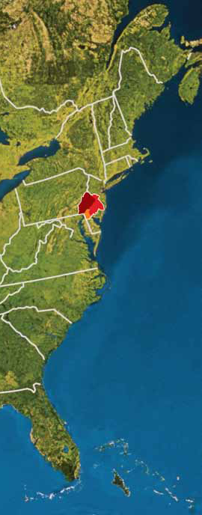
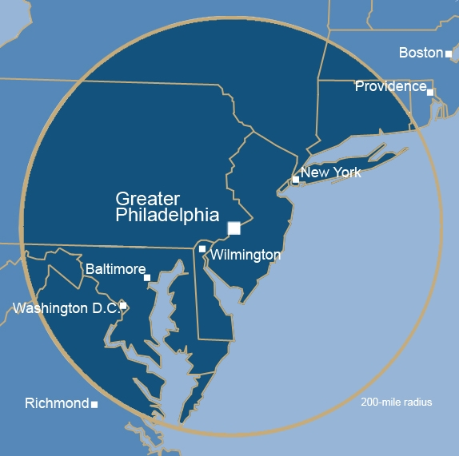
Smart Location: Heart of the World’s 5th Largest Economy
RANK | COUNTRY | GDP ($ trillion)
1 | United States | 14.6
2 | Peoples Republic of China | 5.7
3 | Japan | 5.4
4 | Germany | 3.3
5 | GREATER PHILADELPHIA | 2.8
6 | France | 2.6
7 | United Kingdom | 2.3
8 | Italy | 2.0
9 | Brazil | 2.0
10 | Canada | 1.6
200 Mile Radius

Slide 4
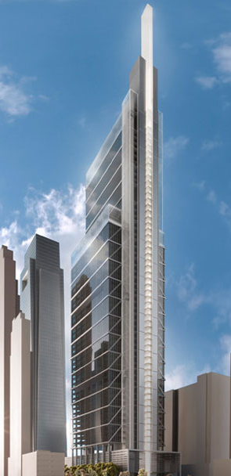
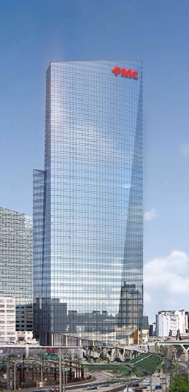
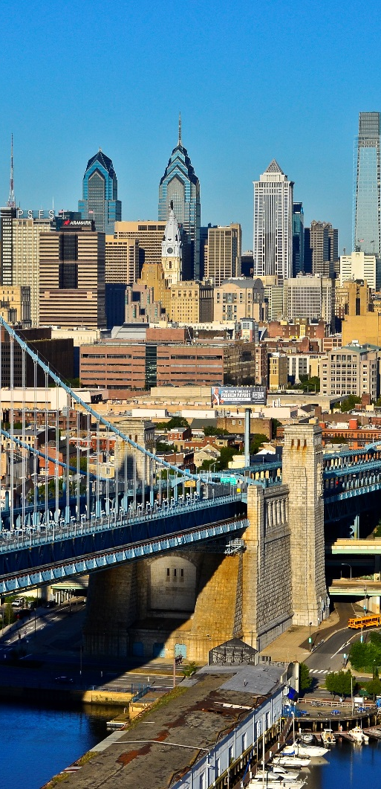

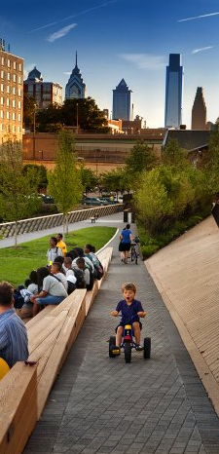
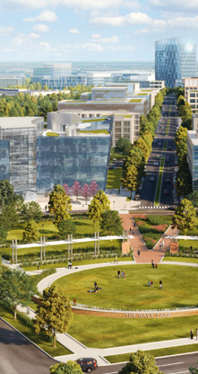
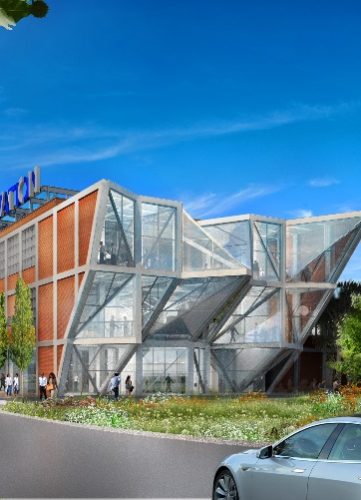
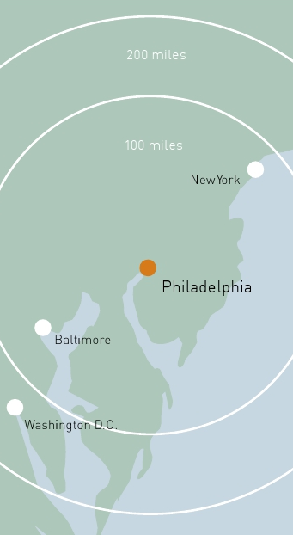
PHILADELPHIA: Value Proposition
Incredible talent pipeline
High quality of life & affordable cost of living
Access to regional and global markets
Competitive business climate

Slide 5
Smart People: Philadelphia’s population has grown by over 70,000 since 2006
Source: US Census Bureau Population Division, Intercensal Estimates of the Resident Population, 2000-2010 and 2010-2014

Slide 6
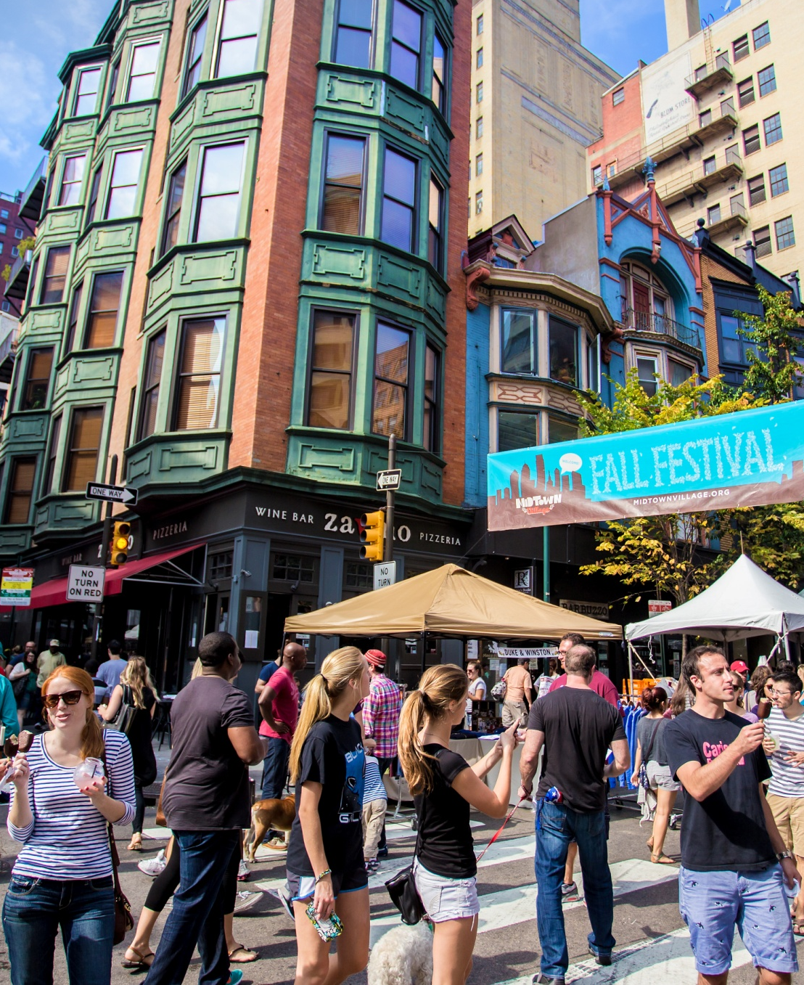
Smart People: Philadelphia is attracting more millennials than any other major city in the US
Among the nation’s 30 largest cities, Philadelphia had the largest percent growth (6.1%) in this demographic; Greater Center City boasts more than twice the national average of residents ages 25-34.
Philadelphia’s millennials are better educated than those in the nation as a whole. In 2013, 39.8% of 25 to 34-year olds in Philadelphia held a bachelor’s degree or higher, while across the nation only 32.9% of the same age group were college graduates.
Philadelphia is home to a burgeoning tech startup scene, and is home to the highest percentage of women in tech talent occupations according to CBRE, 31% in Philadelphia compared to 23.8% nationally.
Midtown Village Fall Festival
Credit: J. Fusco for Visit Philadelphia
Source: U.S. Census Bureau American Community Survey, CBRE “Scoring Tech Talent” Report 2015.
Notes:
From Pew: “Among the nation’s 30 largest cities, Philadelphia’s gain in young-adult population has been as large as any, measured by the percentage-point change in the age group’s share of the overall city head count.” http://www.pewtrusts.org/en/research-and-analysis/reports/2014/01/21/millennials-in-philadelphia-a-promising-but-fragile-boom

Slide 7
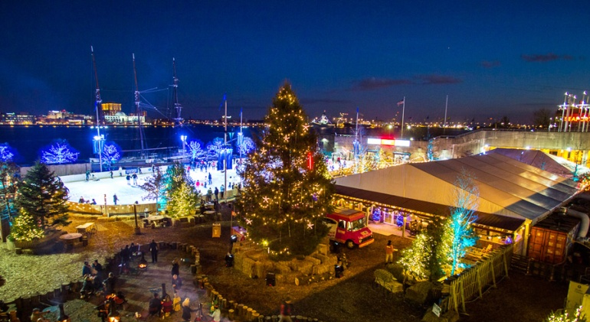
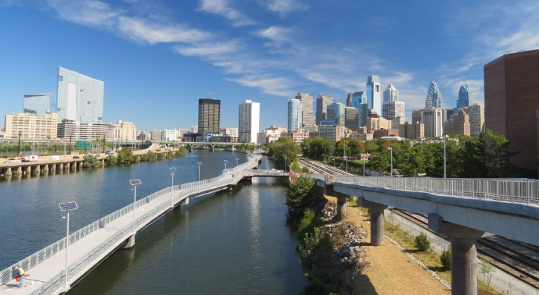
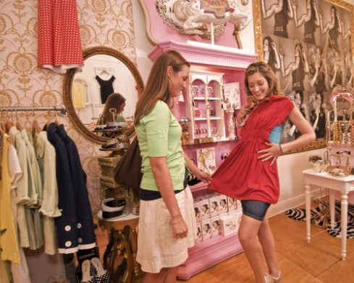

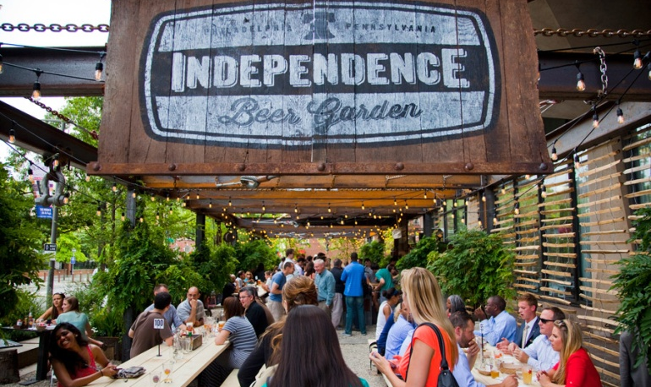
Smart Living: The national and international spotlight is on Philadelphia as a top destination
In 2015, Philadelphia became the first US city to earn recognition as a World Heritage City by the Organization of World Heritage Cities.
Lonely Planet named Philadelphia the #1 Best Place to Visit in the US in 2016. New York Times Named Philadelphia #3 of 52 Places to Visit in 2015.
Philadelphia Named The #2 Best Shopping City In The World By Condé Nast Traveler.
Pope Francis recently visited Philadelphia for the World Meeting of Families and the Democratic National Convention will be held here in July 2016.
Philadelphia has hosted Jay Z’s annual Made in America Festival since 2012 and has been the home of the “Forbes 30 Under 30” Summit for its first two years.

Slide 8
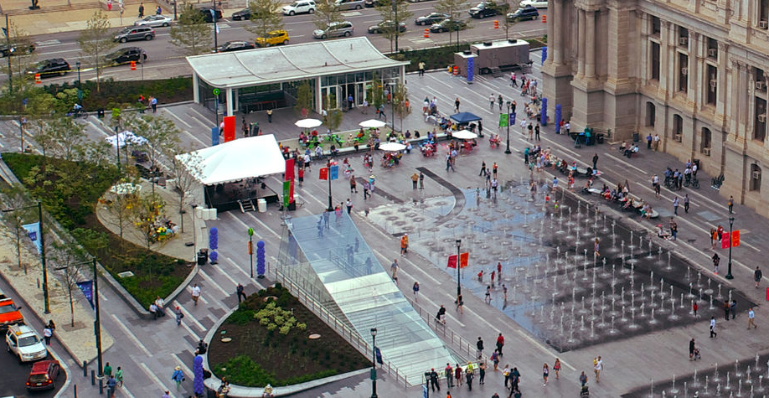
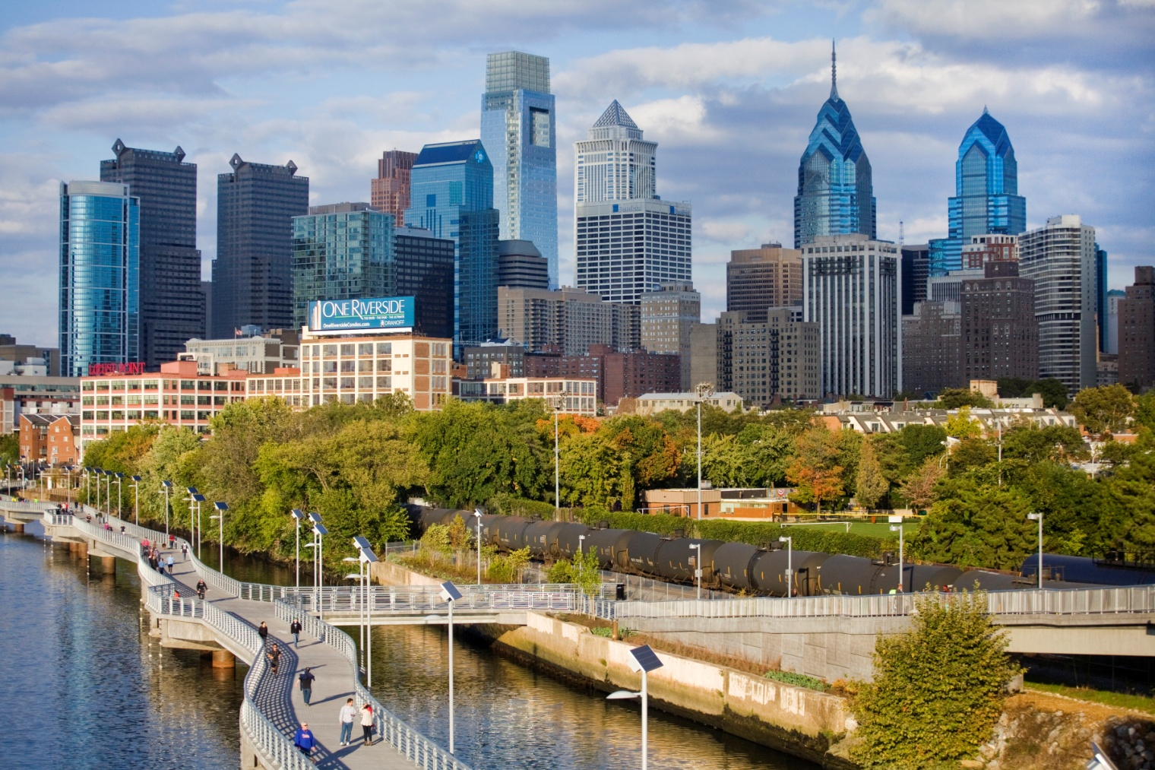


Smart Living: PHL is on the forefront of developing unique public spaces and waterfront amenities

Slide 9
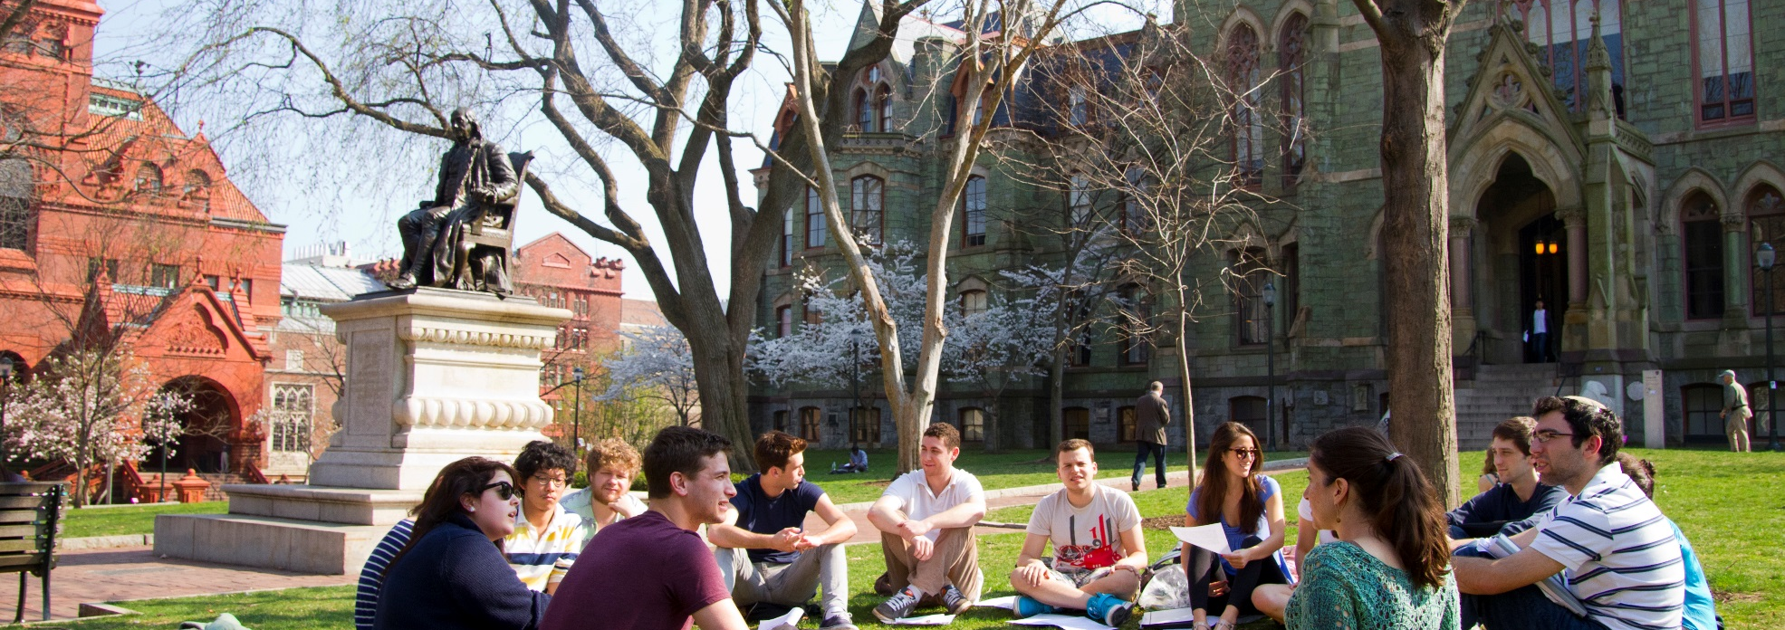
Smart People: 101+ higher ed institutions in greater Philadelphia feed the city’s impressive talent pipeline
Education Pipeline:
Over 100 Degree-Granting Institutions
Approximately 440,000 full & part-time students
Over 90,000 Degrees & Certificates Awarded
Of the 25 largest US Metros:
Highest award rate for first professional degrees
2nd highest award rate for bachelors degrees
Midtown Village Fall Festival
Credit: J. Fusco for Visit Philadelphia
Notes:
From Pew: “Among the nation’s 30 largest cities, Philadelphia’s gain in young-adult population has been as large as any, measured by the percentage-point change in the age group’s share of the overall city head count.” http://www.pewtrusts.org/en/research-and-analysis/reports/2014/01/21/millennials-in-philadelphia-a-promising-but-fragile-boom

Slide 10




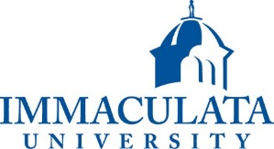





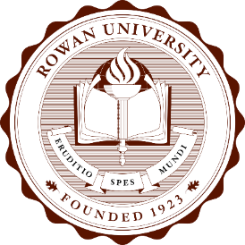



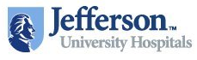





Smart People: Home to top universities & hospitals

Slide 11
Smart City: Philadelphia is a Life Sciences Hub

Slide 12
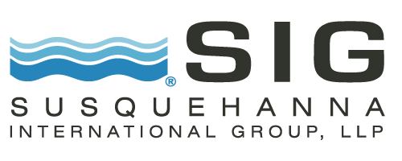


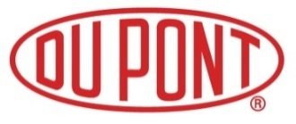
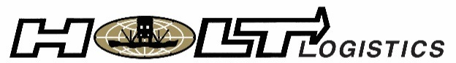





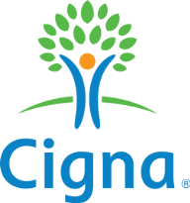


















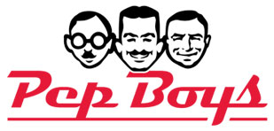








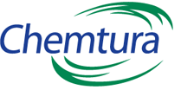








Smart City: Leading Employers in Greater Philadelphia

Slide 13
Smart City: A young and talented workforce drives Philadelphia’s diverse and balanced economy
Education and health services recorded the largest employment gain, adding more than 11,000 jobs in Philadelphia since November 2012.
Greater Philadelphia is the 2nd largest medical research & education center in the United States.
Source: Bureau of Labor Statistics. Quarterly Census of Employment and Wages, 2015. Does not include public sector employment.
Notes:
Manufacturing share shrank the most, Eds and Meds grew the most. Construction + Manufacturing = goods producing. This is just for private sector employment, not including government.

Slide 14
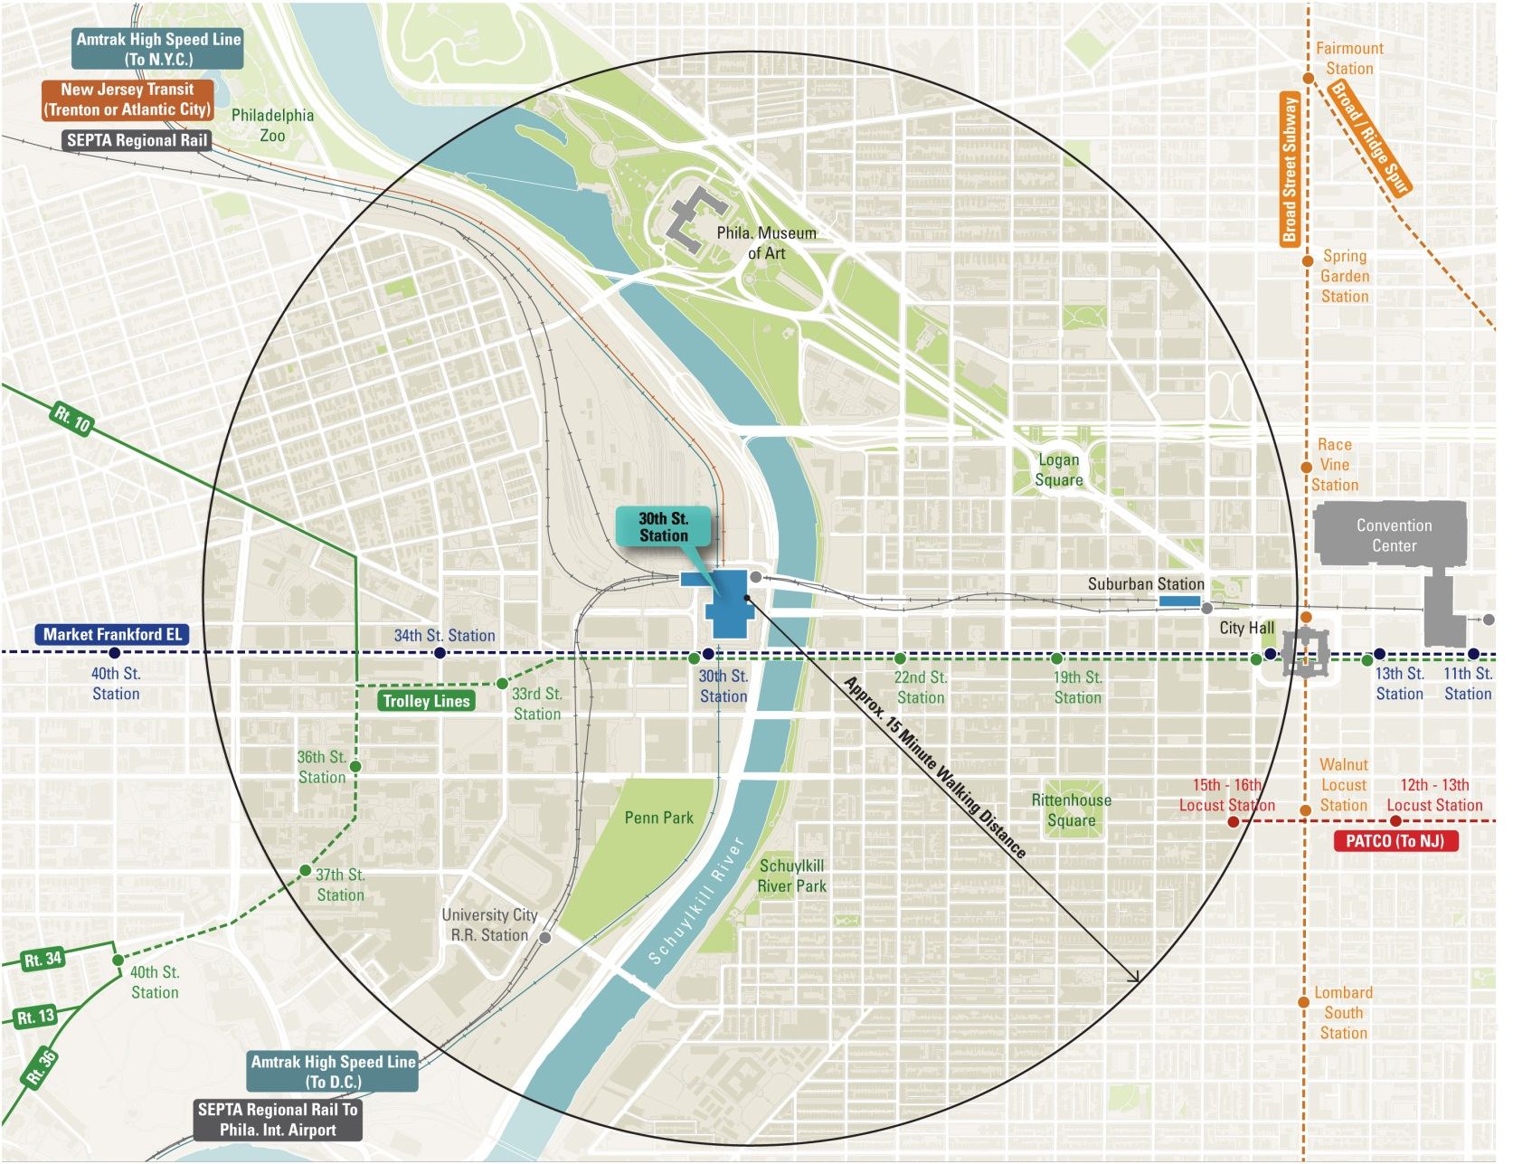
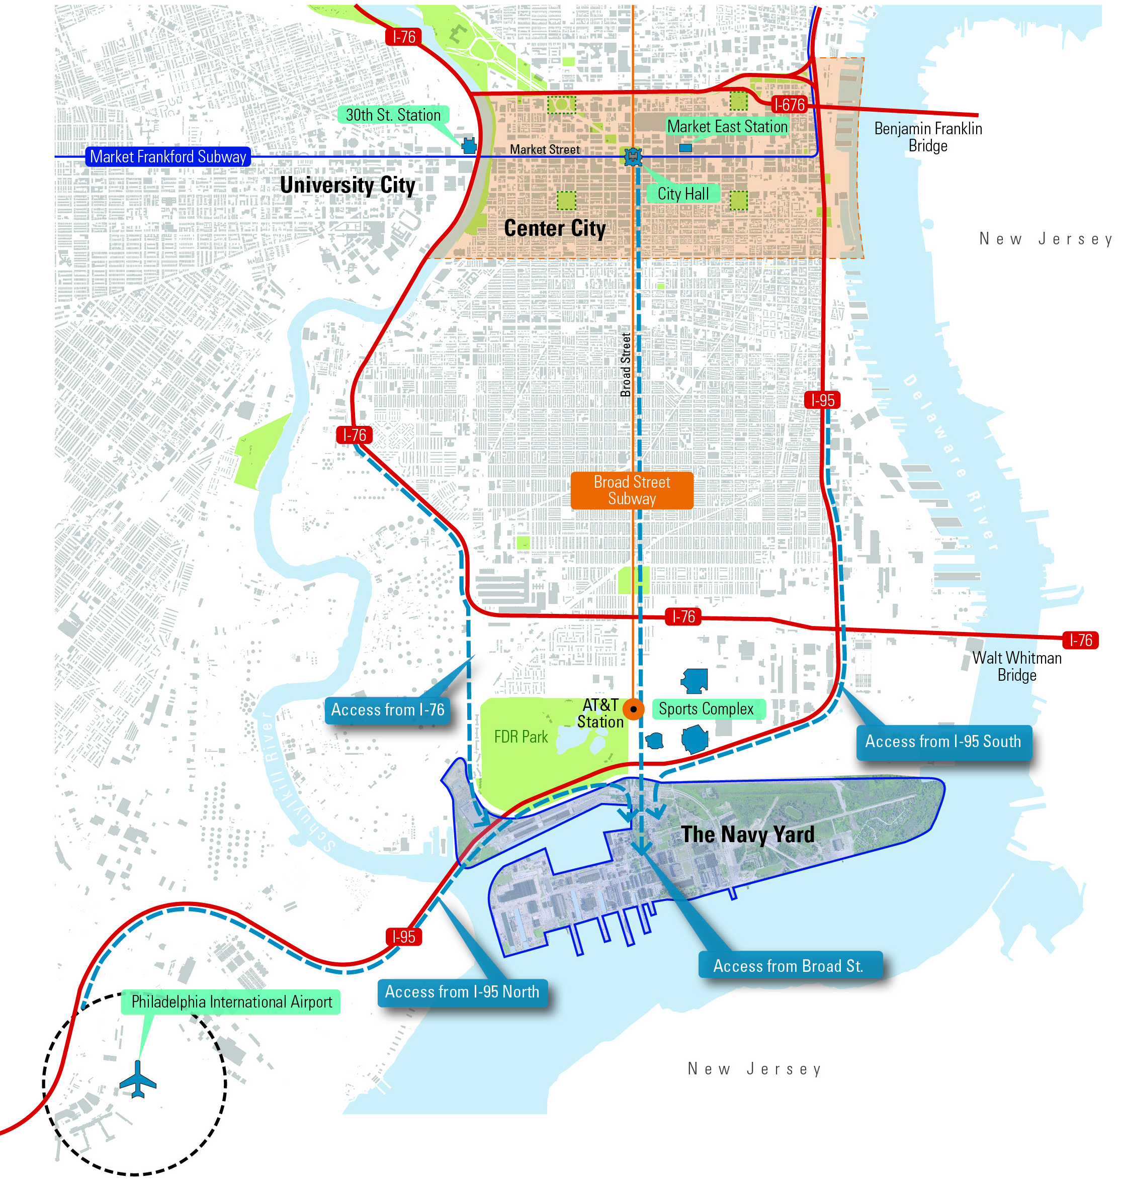
Smart Location: The city’s transportation system supports commuting patterns millennials seek
FACT: Nearly 300,000 riders take transit into Center City daily.
Millennials have the lowest rate of car ownership and listed “location” as a top factor when considering a job.
26.8% of workers in Philadelphia travel to work on public transit, and another 8.2% walk to work.
Philadelphia has the largest share of bike commuters of the nation’s largest cities.
Sources: Pricewaterhouse Cooper, US Census Bureau ACS 2014 1-yr Estimates

Slide 15

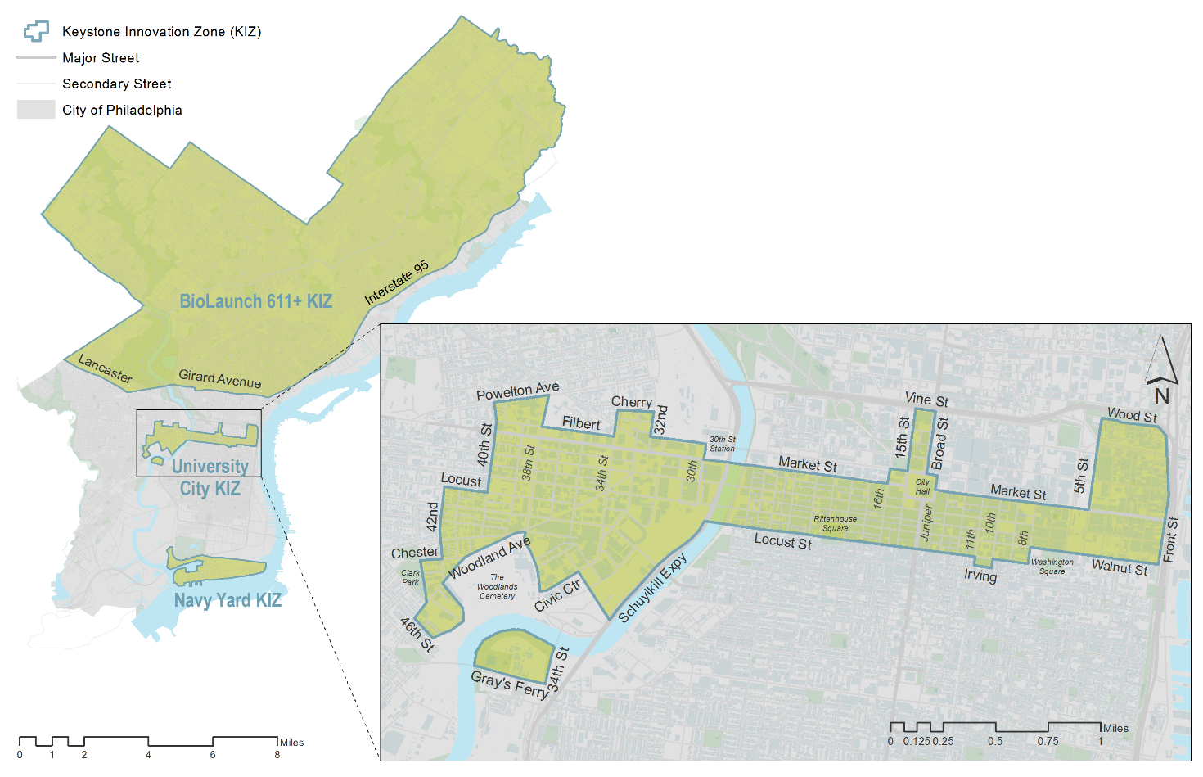
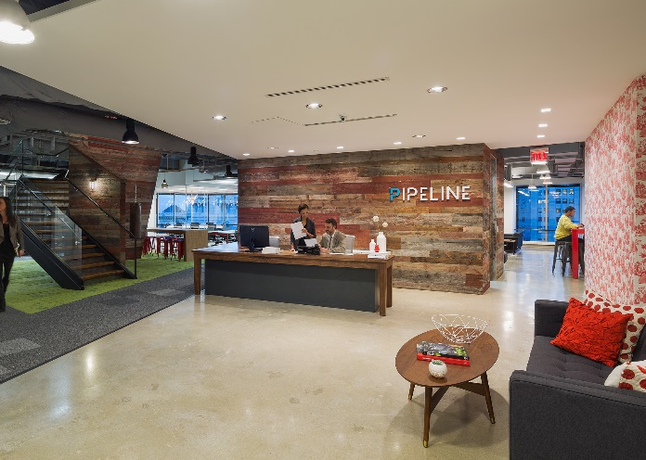
Smart City: Co-working and incubator spaces allow young life science and IT firms to thrive in Philadelphia
Philadelphia is home to more than:
  17 Incubator Spaces
  29 Maker Spaces
  29 Co-Working Spaces
16 co-working spaces in Center City occupy over 200,000 square feet of space for innovation
The City of Philadelphia’s StartupPHL program serves as a resource for local startups
Photo Credit: Pipeline Co-Working Space

Slide 16
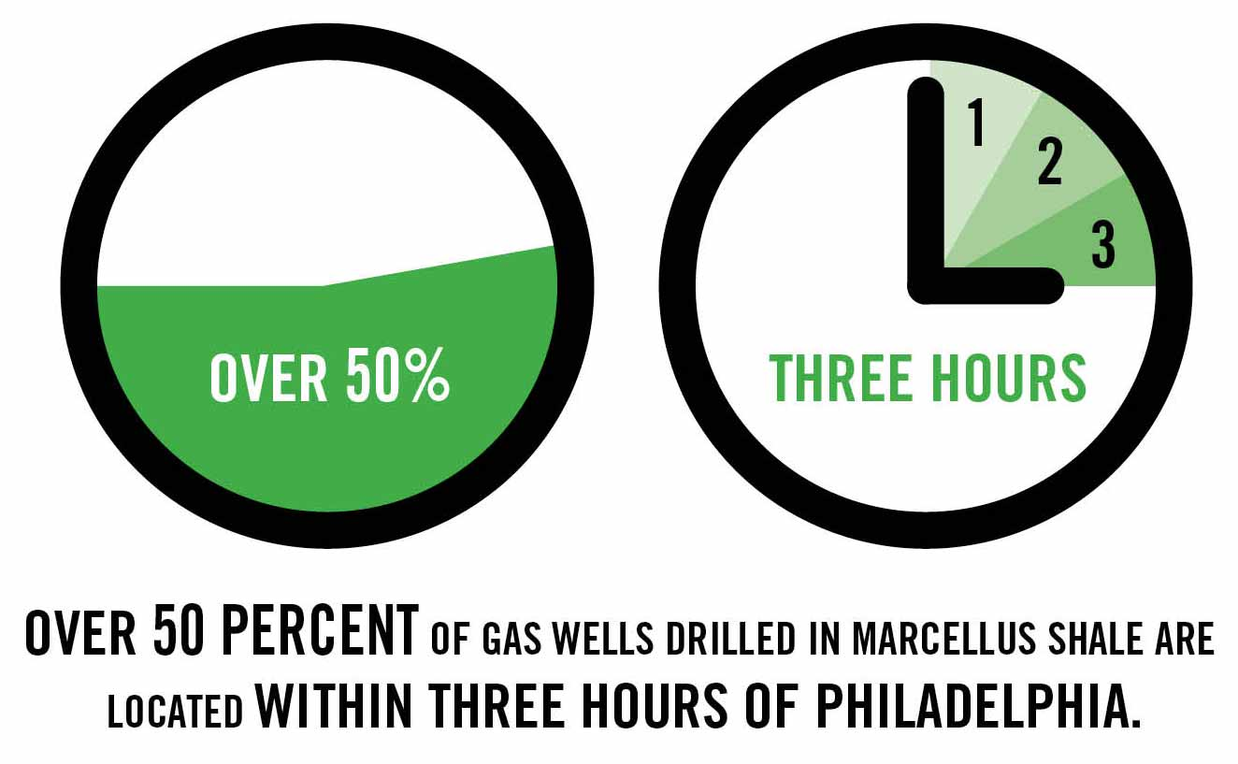
Smart City: Philadelphia’s Energy Renaissance
Marcellus Shale Opportunities
Largest natural gas field in the US
Downstream opportunities in the Phila Region: manufacturing, chemicals, NGLs
Bolstered by superior infrastructure: Top 3 emerging logistics hubs in the US
Three Oil Refineries Repurposed
Sunoco Logistics: Marcus Hook natural gas liquids (NGL) hub
Monroe Energy: former ConocoPhilips plant now produces jet fuel
Philadelphia Energy Solutions/Carlyle Group: Largest oil refining complex on the Eastern seaboard processing 350k barrels of crude oil per day

Slide 17
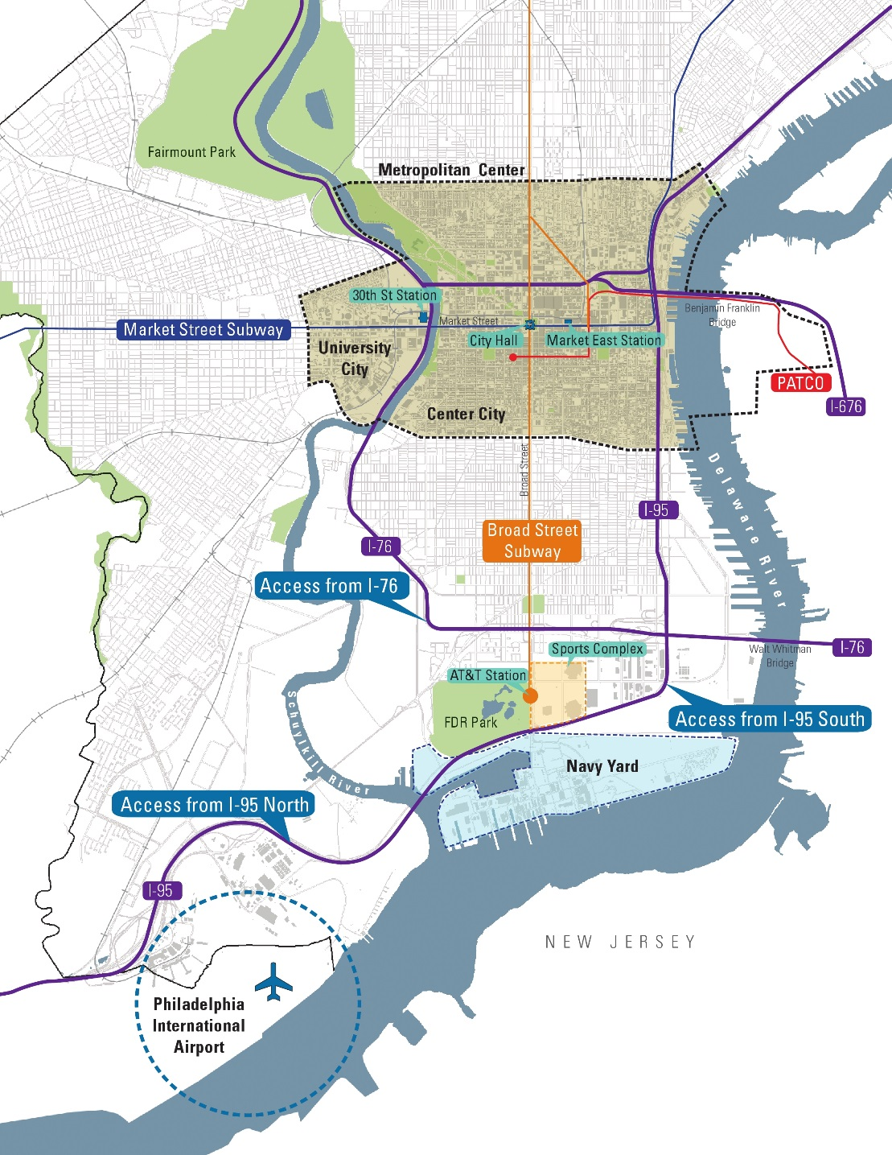
Smart City: Where Are Companies Concentrated?
There are 3 main Commercial Business Districts in Philadelphia with high concentrations of companies:
  Center City
  -Traditional downtown office district
  University City
  -Proximity to universities
  -Innovation
  The Navy Yard
  -Corporate campus
  -145 companies

Slide 18
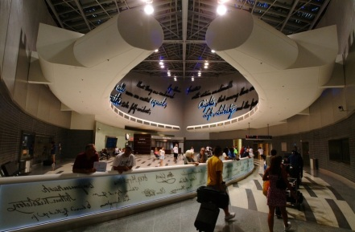
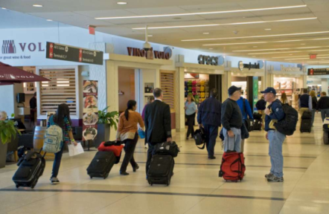
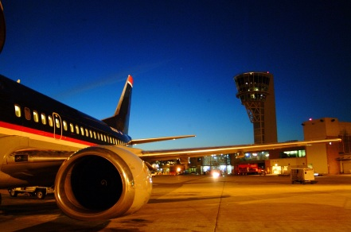
PHL Airport serves as a key economic engine for the sixth largest metro region in the United States
Over 21 million annual O&D passengers from this region including 17+ million traveling from PHL
Nearly 11M residents within a 90-minute drive
500+ daily departures to 130+ non-stop destinations
Average 55-60% origin and destination traffic
Travelers: 50% business / 50% leisure
Approximately 20,000 airport employees
Regionally supports 141,000 jobs / 200 employers
$14 billion (USD) in annual regional economic impact
  2015 total passengers: 31.4 million
  2015 total operations: 411,368
  2015 total air cargo*: 427,643 tons
2015 figures are preliminary * includes mail and freight
Source: Philadelphia International Airport; Innovata schedule data via Diio online portal (YE 3Q16)
18

Slide 19
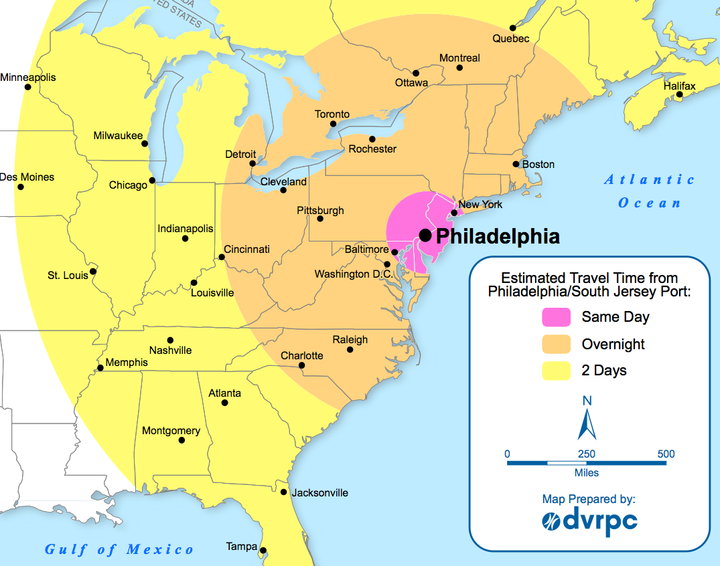
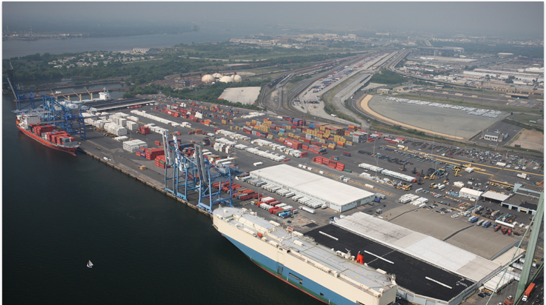
Packer Avenue Marine Terminal
Overview
AREA 106 Acres (42.9 ha)
BERTHS 6 berths with 3,900 linear ft
PLUGS 2,000 reefer plugs
CRANES 7 Container Cranes (2 post panamax)
SPACE 4 million cubic ft- Refrigerated 300,000 sqft- food grade dry
RAIL 2 Class One Rail Roads NS & CSX
INSPECTIONS Onsite USDA, APHIS, Customs
M&R On-Site

Slide 20
Greater Philadelphia: Key Takeaways
Access to the US and the World
    Prime location and Robust Transportation Infrastructure
Top Talent
    103 Universities
    35% of residents = higher education degree
Leading Industries – a spirit of innovation
    Life sciences / Energy / Advanced Manufacturing / Education / Financial Services
Favorable Cost of Doing Business & Cost of Living
Exceptional Quality of Life
Renaissance and Growth – Millennials see the value and opportunities
Sources: U.S. Patent & Trademark Office, Deloitte, City of Philadelphia, Select Greater Philadelphia

Slide 21
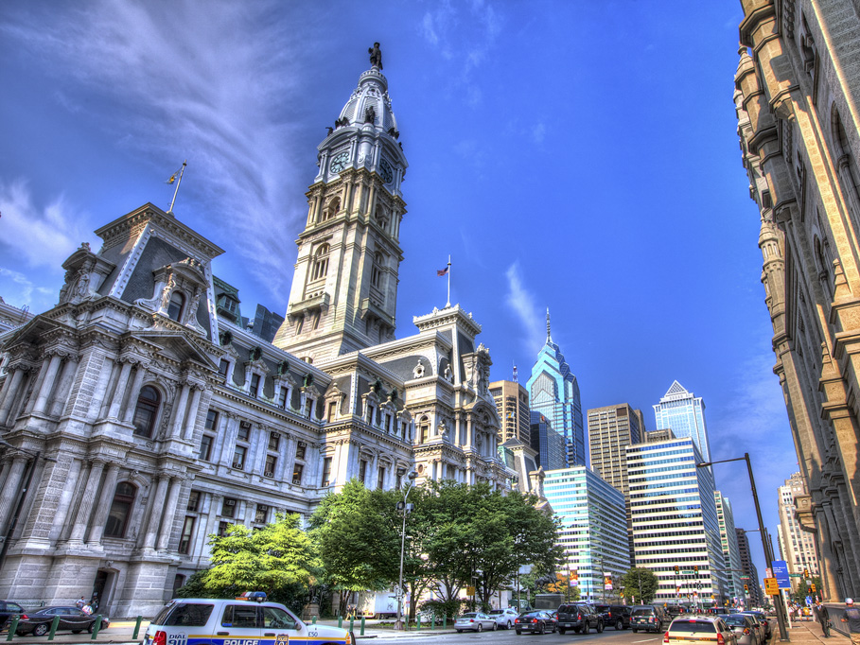
Thank you!
City of Philadelphia Department of Commerce
Harold T. Epps, Director of Commerce
harold.epps@phila.gov
215-683-2001

